Slide 1
Segmentation
P2C and Jungle datasets

Slide 2
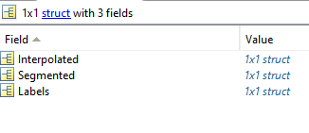
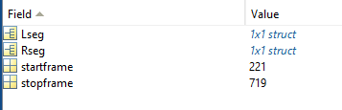

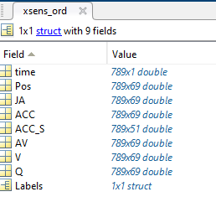
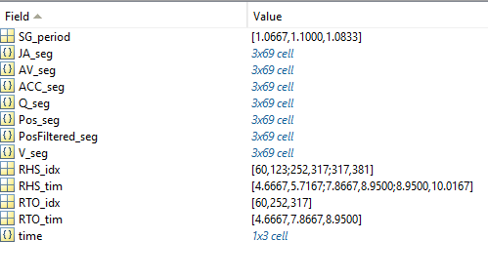
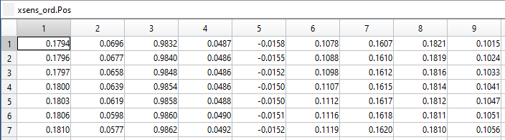
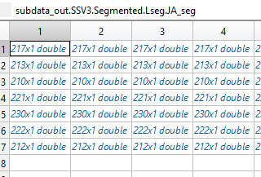
Data segmentation (walking)
Code source: \\fs2\RTO\P2C\Code\Xsens feature extraction
Data source: \\fs2\RTO\P2C\P2C_Database_Segmented - Database paper version
\code_versions_logging.txt
File with a list of the changes from one version to the other of the segmentation code
Code source\2. Gait cycle segmentation\main_STARS_Inpatient_Step03_XSens_GaitSegmentation_v2
Generating a struct with the segmented data over each identified gait cycle
_Extracted.mat
_Segmented.mat

Slide 3
Brief code description (code lines)
Enter folder architecture by condition, participant, and task and trial (1-94)
It removes the first 2 meters of trial, assuming this signal can be noisy (95-114)
Check for axis inversion, by displaying AV left and right shank, y axis. If the user agrees to invert axes, all x and y ACC and AV are changing sign (129-138)
High-pass filter to remove the drift from the position (order=5, cutoff=1) + display the filtered and non-filtered signal (145-160)
Detects heel strike using x left and right foot Pos + plot of the segmentation with the possibility to manually pick the peaks (161-198)
Toe off detection using the heel strikes and the x left and right foot Pos (200-210)
Segmentation and interpolation of all the available data (213-246)
Saving and plotting (249-329)

Slide 4
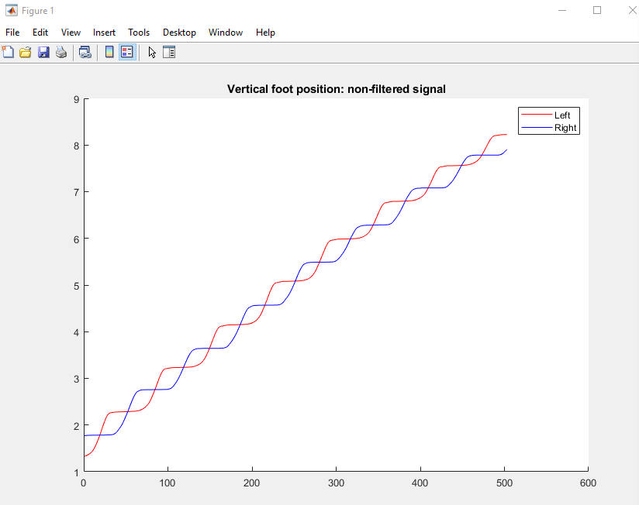
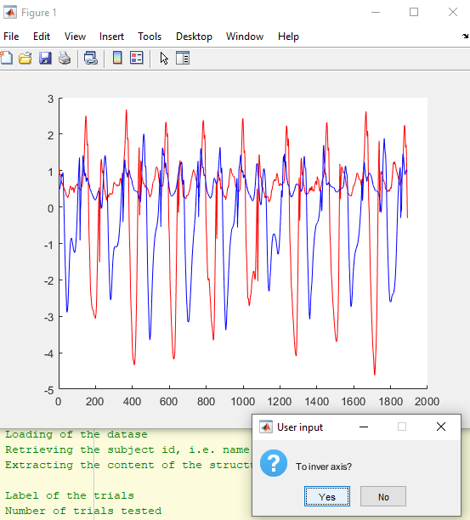
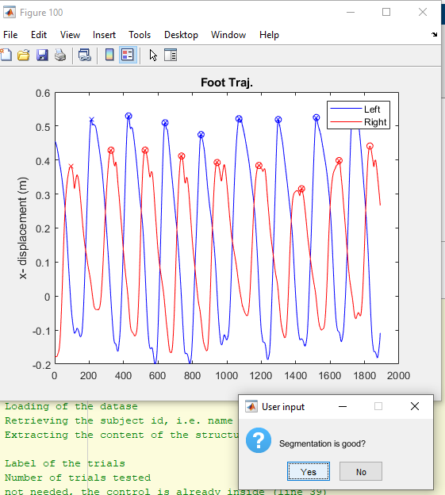
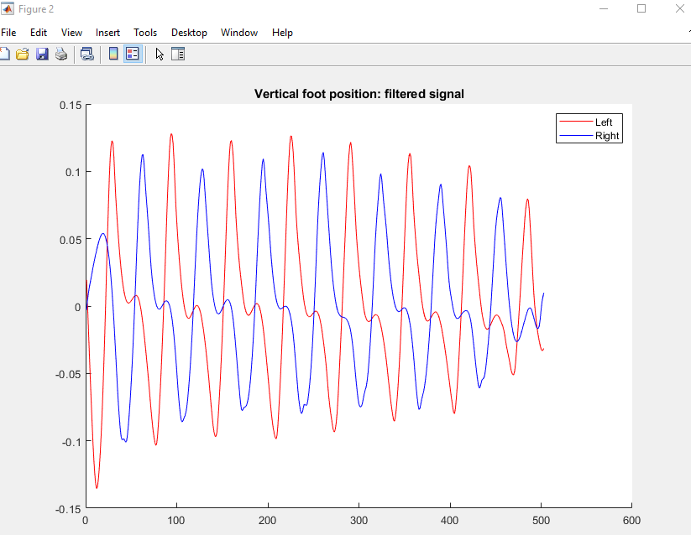
Manual checks of the code
Filtering
(variable plot_verbosity=0 can turn off these plots)
Peak detection
(manual peak detection required in case the segmentation is not considered good)
Axis orientation

Slide 5
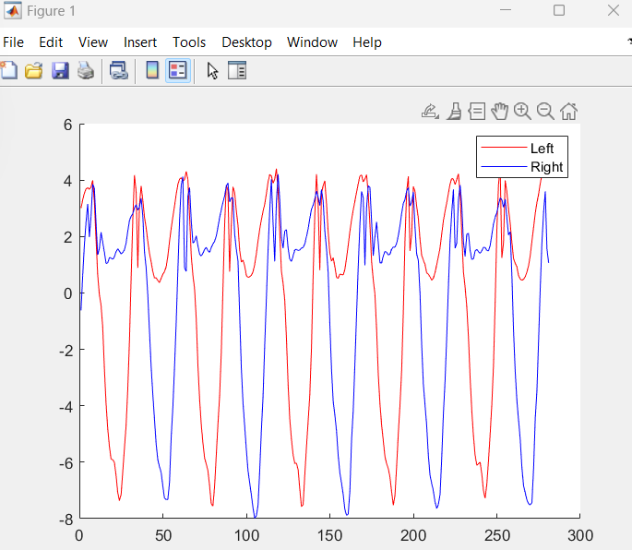
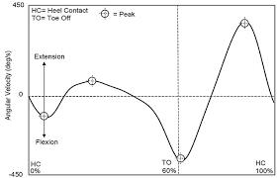
Axis orientation
In this case, you need to ask the code to invert the axis
This an internet example of one stride, a typical shape of a healthy correct AV of the knee
This an example from P2C data of multiple strides, a shape of a healthy participant, AV of the shank, with wrong sign

